Slide 1
MODULAR OT
Operation theatre is that specialized facility of the hospital where life saving or life improving procedures are carried out on the human body by invasive methods under strict aseptic conditions in a controlled environment by specially trained personnel to promote healing and cure with maximum safety, comfort and economy. It is imperative that operation theatre (OT) is designed scientifically to ensure sterility, easy maintenance and effective utilization. A civil – mechanical –electrical – electronic – biomedical combination driven and co-ordinated by needs , preferences and safety of the medical surgical team forms the basis of planning , starting and maintaining an operation theatre.

Slide 2
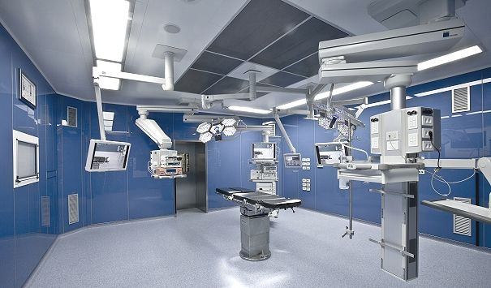

Slide 3
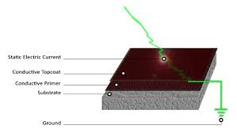
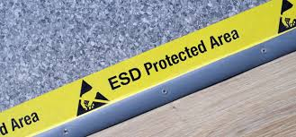
VARIOUS COMPONENTS OF MODULAR AND SEMI MODULAR OT
Antistatic Flooring - ESD vinyl
The flooring confirm to following standards
EN 1081/IEC 613404, EN 1815 & EN 12466.Solid vinyl tile (SVT)(2mm).
2.00mm, total weight 3.0 g/m2 polyurethane reinforced ,scratch resistant, fire resistant, chemical resistant , slip resistant, anti-fungi & bacterial growth , dimensional stability ≤0.40%, static electrical charger < 2Kv , impact sound reduction approx. +4bd, electrical resistant.

Slide 4
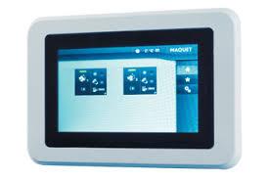
Operation theatre control panel , surgeon control panel All the controls within the theatre should be located on a control panel mounted recessed in the theatre wall. The panel will incorporate all the necessary controls for the correct operation and monitoring of equipment and services within the operating theatre. Each control panel shall contain:
Display & control for Temp & humidity.
Control of Venetian blinds in windows & doors.
Status Indication of up to 5 Medical Gases + 1 Vacuum.
On/Off and regulation of Intensity of illumination in OT.
Digital Display of Real Time / Elapsed time
Intercom with speaker & microphone.
Microprocessor controlled Liquid Crystal Text Backlit display with 4 lines of 20 characters each.
There should be five illuminated buttons for Test, acknowledge, scroll, text & Menu.
Audio-visual alarms.
Normal, Warning & Alarm LED indications. Certificate of country of origin and manufacturers test certificates to be submitted after installation

Slide 5
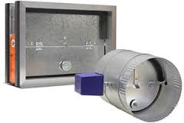
Over Flow Port
Provided in theatre to prevent cross contamination of air from clean and dirty areas.
Over flow port will be strategically placed, enable differential room pressure to be maintained and ensure that when doors are opened between clean and dirty area.
Over flow port, made of Stainless Steel 1.4301 (SS 304 grade)
Have filter element, which should be openable & cleanable.
Volume to be exhausted be between 175m3/h to 200m3/h. Certificate of country of origin and manufacturers test certificates to be submitted after installation

Slide 6
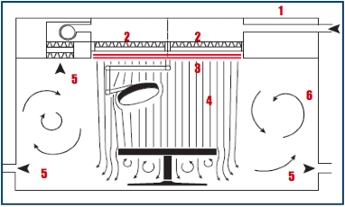
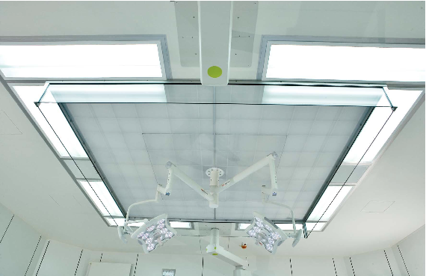
Laminar air flow
One of the main objectives of any operating theatre system is to dilute the bacteria generated by the operating team and patient in the theatre and to create an Air flow pattern that carries contaminated air away from the operating table & entering surgical wounds. A Laminar Flow System should contain three basic elements – a blower, a high efficiency air filter and a Plenum with a diffuser. The turbulent air upstream should change to a Laminar flow by the filter, Plenum and diffuser into straight-line flow off the downstream face of the filter. Filtered air should descend in a uni-directional flow over the patient, creating a “Clean Zone”, rapidly removing contamination generated within that zone and preventing entry of contaminated air. Average air velocity below the plenum, should be 0.24 meters per second The Modular OT system shall be supplied together with Vertical Laminar Air Flow ceiling system only. The laminar box size shall be minimum 3000mm x 3000mm for all the OTs with air volume delivery should not be less than 7000 m3/h at discharge velocity ranging between 0.24m/s to 0.30m/s maximum.

Slide 7
Design parameters:
Average air velocity below the plenum, be 0.24 meters per second
The laminar airflow ceiling shall have Filters of H14 grade, EN 1822 standard.
Double tight seat system to prevent leakages from sides of filter gaskets, filter frame and pressure frame.
Mini-perforated plate/sheet; the vertical flow should achieve homogeneous flow.
The vertical flow should ensure a sterile area of stable air hygiene over the operating table.
Laminar airflow system shall comply with internationally accepted standards & meet with ISO Class 5 requirements.
The air management system will be designed to achieved the following Parameters
Bacteriological class =B (10 CFU/m3)*
Particle decontamination kinetics CP =5 min
Biological decontamination kinetics CB = 5min
ISO 14644/1 classification = ISO 5
Certificate of country of origin and manufacturers test certificates to be submitted after installation

Slide 8
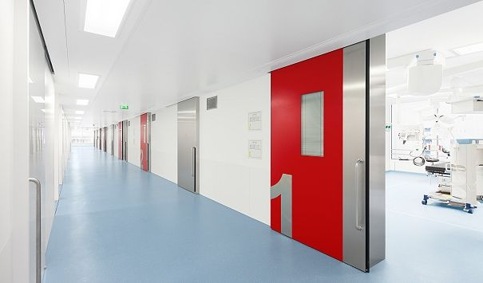
Automatic sealing Sliding Doors
All doors & door frames shall be made of stainless steel Material-Nr. 1.4301, SS 304 grade only.
Thickness of SS sheet used for door frame & door panel surfaces shall not be 1.5mm. There shall not be any visible screws or similar other uneven surfaces on the door pane
All doors should have sturdy SS door handles on both sides. A lock shall be provided on each door.
All doors shall have vision panels (viewing window) at least 300mm x 300mm.
Automatic doors shall have potential equalization (earthing) as per VDE 0107 or equivalent guaranteed by a sliding contact. Its automation unit shall be short-circuit proof and shall have an integrated power supply unit 200-240V, 50-60 Hz, 24V~/2A and shall comply with ISO 9001 and CE requirements.
There are two sizes required 2100mm x 1500mm & 2100mm x 900mm, SS door frame grid is to be designed accordingly. The door leaf should have sealing system in closed position.
Vertically placed conductive push strip of minimum 1.0 mt height on both sides of the door for Auto operation by elbow, foot or knee for entry / exit.
Separate entry push buttons for OT staff, trolley.
Dedicated push button on one side of door for cleaning purpose i.e. during cleaning area near OT door, if required the said button is pressed which open the door will remain upon until pressed again.
All the buttons & conductive push strip mounted on SS door frame and pre-wired internally from factory.

Slide 9
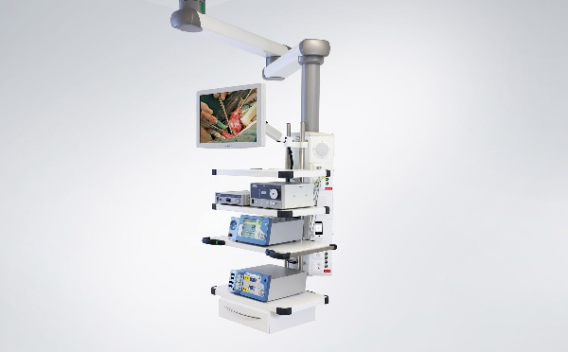
Surgical Pendant
Certified as per Medical Device Directives (93/42/EEC) having the CE mark Class IIb medical device with notified number specified. Third party certification to EN 60601 Medical Equipment Electrical Safety.
Compliant to BS EN 7396 NHS health technical memorandum model engineering specification from the certifying agency with copy of certificate of origin
The Surgical Pendant is capable of lateral and vertical movement, using a double arm system.
The pendant have an electro-magnetic braking system.
The Pendant have visual colored brake indicators to indicate which joint movement has been released. It should fully conform to HTM 02-01 Standards.

Slide 10
The Surgical Pendant have a compact service console, 900 mm in length and containing the following services, fully installed and tested:
Front Mounted 38mm Multifunction Rack, providing accessory mounting and docking solutions.
5 No. Shelves with 1 drawer each mounted on the multifunction Rack and edged with Medical Rail. All shelves are fully height adjustable.
Rear Mounted Handle With Brake Controls.
10 No. 230V 13A Socket Outlets
2 No. Medical Oxygen Terminal Units
2 No. Medical Air 4 Bar Terminal Units
2 No. Surgical Air 7 Bar Terminal Units
2 No. Medical Vacuum Terminal Units
1 No. Medical carbon dioxide Terminal unit
1 No. Twin RJ45 Data Outlet
2 No. Single Gang Provisions for Data Services
The pay load of the pendant 200 kg.

Slide 11
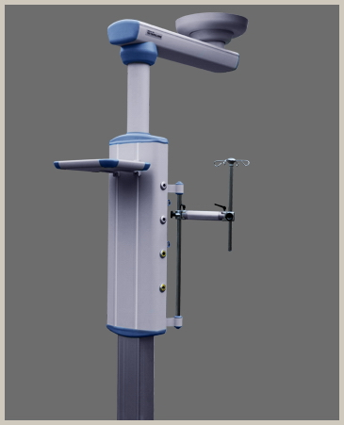
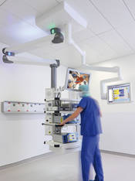
Anesthetic Pendant
Certified as per Medical Device Directives (93/42/EEC) having the CE mark Class IIb medical device with notified number specified. Third party certification to EN 60601 Medical Equipment Electrical Safety.
Compliant to BS EN 7396 NHS health technical memorandum model engineering specification from the certifying agency with copy of certificate of origin
The Anesthetic Pendant capable of lateral and vertical movement, using a single arm system
The pendant have an electro-magnetic braking system. The Pendant Arms have visual colored brake indicators to indicate which joint movement has been released.
It fully conform to HTM 02-01 Standards. Certificate of country of origin and manufacturers test certificates to be submitted after installation

Slide 12
Pendant should have a compact service console, 900 mm in length and containing the following services, fully installed and tested:
Front Mounted 38mm Multifunction Rack, providing accessory mounting and docking solutions.
3 No. Shelves mounted on the Multifunction Rack and edged with Medical Rail. All shelves are fully height adjustable.
Rear Mounted Handle With Brake Controls.
10 No. 230V 13A Socket Outlets
2 No. Medical Oxygen Terminal Units
2 No. Medical Nitrous Oxide Terminal Units
2 No. Medical Air 4 Bar Terminal Units
2 No. Surgical Air 7 Bar Terminal Units
2 No. Medical Vacuum Terminal Units
1 No. Medical AGSS Terminal Unit
1 No. Medical Carbon Dioxide Terminal Units
1 No. Twin RJ45 Data Outlet
2 No. Single Gang Provisions for Data Services
The pay load of the pendant be 175kg.
The pendant have a wide range of maneuverability.

Slide 13
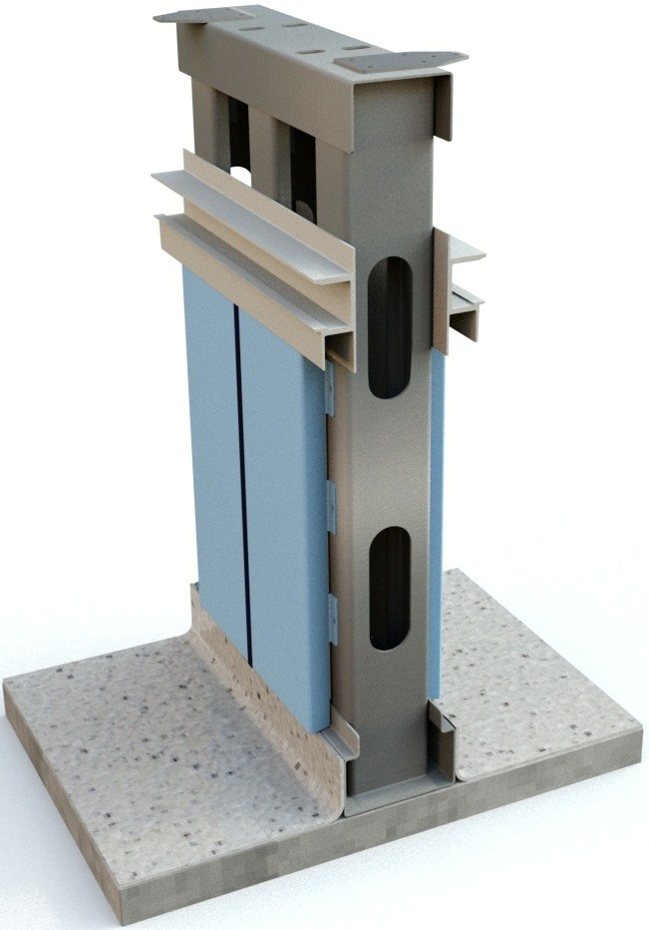
Modular Wall Panels
Surface clean room side made of be stainless steel 1.4301 (AISI 304), powder coated, color white RAL 9010 or choice of color from shade card, with anti microbiological coating to be provided
All the Operating Theatres be fully pre-fabricated and truly modular in design having self-supporting, freestanding substructure.
The free standing substructure shall be made of GI of minimum 1.5mm sheet thickness.
The substructure shall be firmly fixed onto the floor, slab/ceiling RCC with high quality fasteners.
Substructure shall have additional horizontal support (mounting bracket) for medical gases outlets, x-ray viewer, monitors etc. The wall substructure should be calculated considering Floor to Slab height 3600mm
Wall cover panels made of Stainless steel (Material-Nr. 1.4301, SS 304 grade) of thickness not less than 1.0 mm. No other material other than Stainless steel 304 grade shall be used for this purpose.
The SS wall panels shall be reinforced with 18mm non-flammable, high quality plaster board glued on the back of wall panels to make a total thickness of 19 mm (1mm+18mm). Additional insulation to be provided, by high density mineral fiber mats

Slide 16
All the Wall panels, components of the structural material shall be totally prefabricated from the factory itself. All the wall Panels shall be pre-powder coated and no painting job shall be carried out at site.
The pre-powder coating shall be maintained at a minimum deposit thickness of 60 microns and should have JIS Z 2801 certification from third party.
Wall and ceiling panels will be easily openable /closable for quick resumption of operations after repair/maintenance and for future expansion and up-gradation.
Full height silicon rubber seal of Medical Grade shall be used to fill the gap between two wall panels to ensure a 100% hermetically sealed vertical, flush with wall panels mounted joint. In all the corners of the OTs, especially fabricated, one piece, angular SS wall panels shall be used.
The Modular OT wall system shall have certification for hygiene, noise protection, radiation protection & fire protection.
The fire resistance for single paneled wall system including substructure work should be class EI 30 (30 minutes minimum) shall be in accordance with EN 13501-2, EI 1364-1
Metal structure work should be in accordance to DIN 18545.
CE compliance certification for all modular construction related components
The powder coating on wall panels should have third party (from reputed Lab) certification on compliance according to JIS Z 2801 standard.
Certificate of country of origin and manufacturers test certificates to be submitted after installation

Slide 17
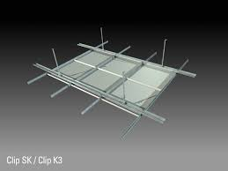
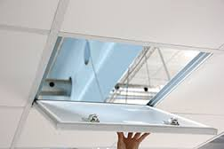
Modular False Ceiling
Clamping ceiling, cassette ceiling, galv. sheet steel 1.0 mm, non-perforated White wet-coated surface coffered ceiling grid 600 x 600 mm or 1200 x 600 mm including substructure
Coating of the Ceiling Panel shall be not less than 40 micron with 180°C stove enameling and the color RAL 9010, Off-white or powder coated.
The ceiling panels shall be secured by means of clip system and punched-in-knobs shall keep the panels in place and shall ensure an exact ceiling level.
The panels are openable for future repair / maintenance & up-gradation. Certificate of country of origin and manufacturers test certificates to be submitted after installation

Slide 18
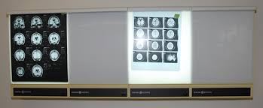
X-ray view screen -
X-Ray viewing screen of size 1050x430mm
Four shutters for non-dazzling diagnostic use with flicker-free HF light and variable control range of luminous intensity,
Control range approx. 90%,
Flat film holders of silver anodized aluminum profile with masked grip on all 4 sides of the viewing area.

Slide 19
Writing cum List Board
Flush mounted white laminate board, opened to create a wall mounted writing surface within the operating room. The white board be constructed from white laminate board.

Slide 20
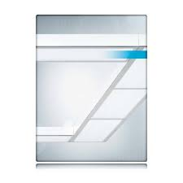
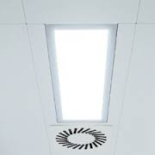
Clean-room luminaries with frame
Clean Room Luminaries, IP 65, recessed type to be provided in OTs for general illumination.
6-8 nos. of IP-65 grade T16-lights, with dimming (intensity) control, each light
1000 Lux illumination above 1 MTR floor level around the OT table.
The light fixture will be hermetically sealed from top side (ceiling side) have bottom opening for repair & maintenance.
Magnetic locking with the frame with no screws visible from the bottom.
Certificate of country of origin and manufacturers test certificates to be submitted after installation

Slide 21
LED Operating Theatre Light
The Operating Theatre Light will comprise of a double structure with 2 lamp heads (main and satellite.)
The lamp heads have multiple LED light sources including a combination of red and white LEDs to optimize colour rendition
The light have a Comfort Halo, to reduce eye strain for surgeons by creating a more gradual change in contrast between the illuminated area and areas under general lighting.
Each lamp head allows for a wireless link to a wall mounted remote control to repeat all controls and indicators including:
Lamp head On/Off Control
Intensity
Colour adjustment
Field Size

Slide 22
The Operating Theatre Light meet the following technical parameters:
Light Intensity – 160,000 Lux (Main) & 160,000 Lux (Satellite)
Light Field Diameter (d10) – 200-420mm (Adjustable)
Light Field Diameter (d50) – 120-250mm (Adjustable)
Beam Uniformity (d50/d10 Ratio) – 0.6
Comfort Halo – 2,000mm
Lamp Head Nominal Power Consumption – 48W
Radiant Energy mW/m².Lux - <3.31
IP Rating of Light Engine – 54
LED Life - >60,000 Hours
Color Rendition Index:
Ra – 95
R1 – 99
R2 – 97
R3 – 93
R4 – 93
R5 – 98
R6 – 96
R7 – 94
R8 – 92
R9 – 95
Red Balance Control to provide colour temperature of – 3100° K, 3400° K, 3700° K, 4100° K and 4600° K
Removable, Sterile Handle
Anti-Microbial Coating
Number of LED Light Sources: 90 (Main) + 39 (sat)
Certificate of country of origin and manufacturers test certificates to be submitted after installation

Slide 23
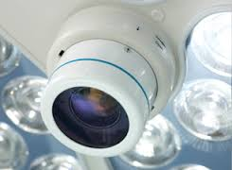
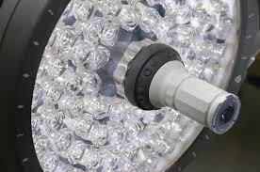
HD Camera for OT Light
Integrated camera to be fully enclosed within the lamp head and behind the OT lamp protective front lens in order to provide a permanent, robust and secure solution with reliable connectivity.
Direct Digital technology transmit a 1080i HDSDI signal directly from the camera, without processing or scaling, loss of resolution or image detail.
Zoom controls provided on the lamp head.
Option for full camera control via a secure wireless remote control including control of:
Zoom control
Auto/Manual Focus
Auto/Manual Iris
White Balance Control
Freeze Image
Black and White / Colour Selection
Digital Zoom Enable/Disable Selection

Slide 24
HD Camera System comply with the following technical parameters :
Effective picture elements - Approx 2,000,000 pixels
Video Signal - HDSDI: 1080i/59.94
Lens - 10x zoom F1.8 to F2.1) F=5.1 mm (WIDE) to 51 mm (TELE) Zoom movement speed Optical WIDE/Optical TELE 1.0 sec Optical WIDE/Digital 4x TELE 1.5 sec Digital WIDE/Digital 4x TELE 0.5 sec Focus Movement °° to Near 0.1 sec
Digital zoom - 12x (120x with optical zoom)
Angle of view (H) - 50 degree (WIDE end) to 5.4 degree (TELE end)
Min. object distance - 10 mm (WIDE end), 800 mm (TELE end)
Min. illumination (Typical) - 12 lux (F1.8) with 50 IRE
1.0 lux ICR On (F1.8) with 50 IRE
S/N ratio - 50 dB or more
Electronic shutter speed - 1/2 to 1/10000 sec. (21 steps)
White balance - AUTO, WB/Indoor/Outdoor/One Push WB/Manual WB
Gain - Auto/Manual (-3 to +18 dB, 8 steps)
AE control - Full Auto/Shutter Priority/Iris Priority/Manual/Bright/Spot AE
Exposure compensation - ± 10.5 dB (15 steps in a unit of 1.5 dB)
Aperture control - 16 steps
Picture effect - Black & white, still image (frozen)
Focus - Full Manual / Auto (Normal AF/ Interval AF/ Zoom Trigger AF)
Camera Control interface - External communications via Medical Secure i2i wireless interface.
Storage temperature/Humidity - -20 to 60°C (-4 to 140°F)/20 to 95%
Operating temperature/Humidity - 0 to 45°C (32 to 113°F)/20 to 80%
Power requirements/Power consumption - 6 to 12 V DC/4.8 W. Powered from OT light medical safety power supply. Fully powered during emergency battery operation

Slide 25
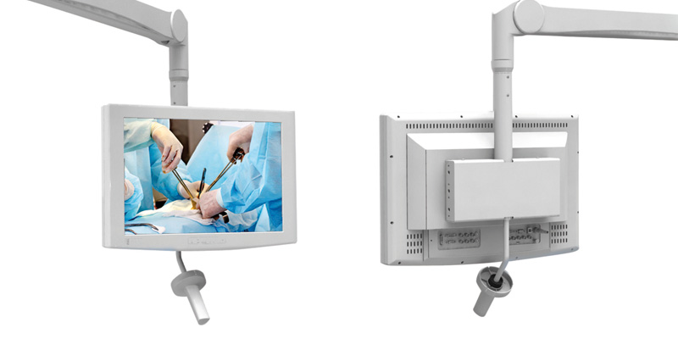
HD Monitor
High Definition with dimension of 22”. Monitor medically approved with easy controls via OSD Jog wheel interface
Edge to edge non-reflecting glass surface making it hygienic and easy to clean.

Slide 26
The monitor conform to the following parameters :
Screen Design - True Flat design with edge
to edge wipe clean protection glass with AG coating
User Controls - Jog wheel control and On screen
GUI Size - 21.5” / 54.6 cm
Panel backlight - LED
Aspect ratio - 16:9
Active area (H × V) - 476.5 × 268.11 mm
Resolution - 1920 × 1080
Pixel pitch - 0.248 × 0.248
Display colours - 16.7 M
Luminance/Brightness - 300 cd/m2 typ.
Contrast ratio - 5000:1
Viewing angle (H × V) - 178° / 178°
Response time typ. - 16 ms
Video Input Ports - HD-SDI (3G), DVI
Power consumption - ~30 W
Dimensions (W × H × D) - 537.4 × 384.4 × 175.0 mm
Temperature operating - +10 °C to +40 °C
Humidity operating - 30 to 75 % RH
Power supply - 24 VDC
Mounting - VESA 100
Regulatory Compliance - EN 60601-1 3rd; UL60601-1 3rd, RoHS
Certificate of country of origin and manufacturers test certificates to be submitted after installation

Slide 27
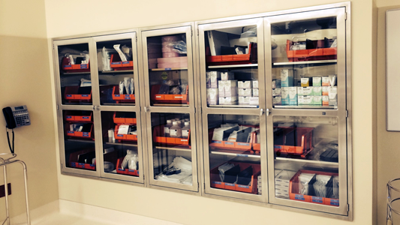
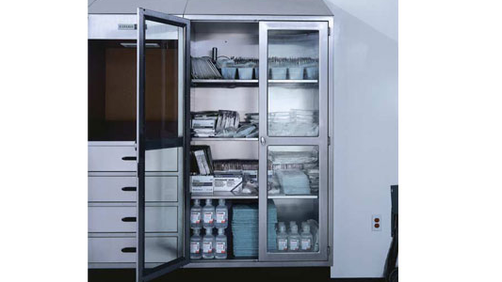
Storage Unit:
Storage cabinet of dimension 2100 x 900 x 600 (HxWxD) mm
The storage cabinet shall be made of SS specification, same as used for wall panel,
The door panels of the cabinet shall be in Stainless steel & partly in tempered glass.
The storage Cabinet should have 4 trays. Certificate of country of origin and manufacturers test certificates to be submitted after installation

Slide 28
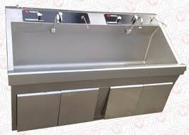
Scrub Station:
Two bay scrub station shall be made of stainless steel Material-Nr. 1.4301, SS 304 grade with minimum 1.25mm thickness.
Each sink of the scrub station have two soap dispensers and a tap operated with an independent optical sensor with timer mode. The tap have an automatic mixer for hot & cold water through a temperature regulator.

Slide 29
Pass Through Box
Pass Through box of dimension 600mm (width) x 600 mm (Height) x 600mm (Depth).
Made of SS 1.4301 (304 grades), thickness of the sheet to be used is 1.25 mm.
The door panels of Stainless steel and partly in glass.
Both doors electro-mechanically interlocked so that only one side door could be opened at a time.
Certificate of country of origin and manufacturers test certificates to be submitted after installation

Slide 30
HEPA Filter Air Outlets
H13 grade, according to DIN EN 1822 standard complying with DIN 1946-4 standard, to be provided.
Each Air filter capable to deliver 550m³/h air volume, pressure drop 130Pa
Filter Frame made of extruded aluminum & factory testing for Leakage
Filters are fitted with a lip seal into an installation sub frame with two or four fixing points.
Equipped with a sealing integrity test facility, internal measuring tube, and pressure measurement point for monitoring the operating differential pressure. Suspension and pressure measurement points either at the side or at the top.
Casing made of sheet steel, powder-coated RAL 9010, pure white
diffusers made of sheet steel, powder-coated RAL 9010
Air-filter Outlet size:
Nominal size: 625mm
Connection diameter: 248mm
Height of the casing: 384mm
Certificate of country of origin and manufacturers test certificates to be submitted after installation

Slide 31
Antibacterial wall paint
Following Killing Time for most commonly found microbes in Operation Theater
Description | Plain Plates Survival Time | Coating Killing Time
Staphylococcus Aureus Type 80/8 | 24Hrs | 1Hr
Escherichia Coli NCTC 10418 | 24Hrs | 1-2Hrs
Pseudomonas Aeruginosa | 24Hrs | 4-5Hrs
Beta Hemolytic Streptococcus | 5-24Hrs | 3Hrs
Salmonella Typimurium | 24Hrs | 4-5Hrs
Candida Albicans (Fungus) | 24Hrs | 2-3Hrs

